Slide 1
The rebirth of neuromorphic accelerators
marc.duranton@cea.fr
www.cea.fr

Slide 2
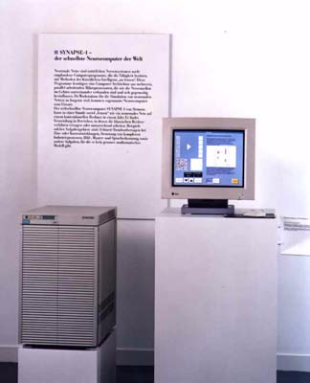
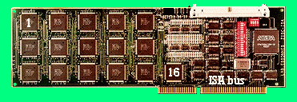
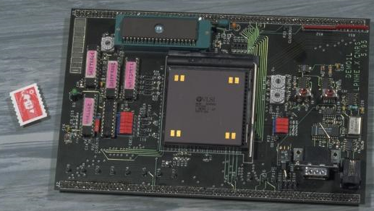
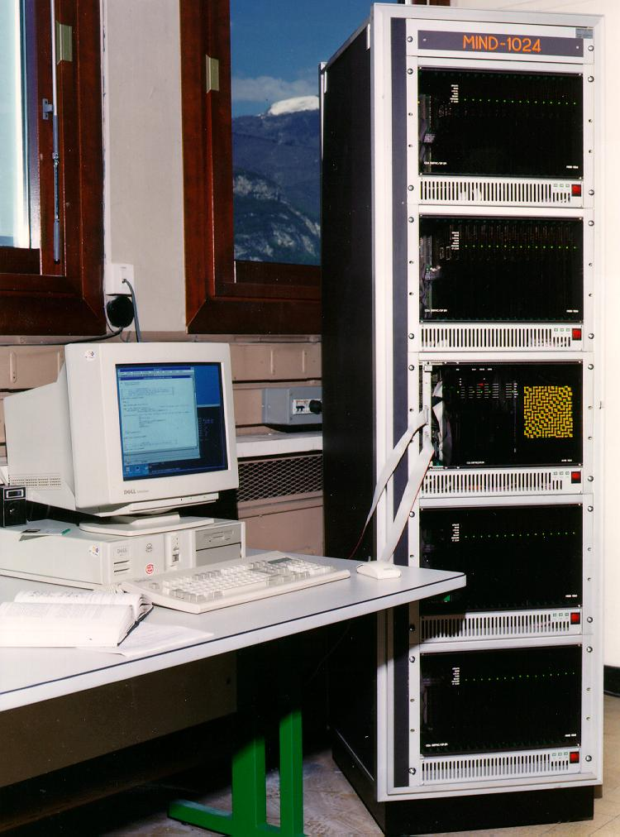
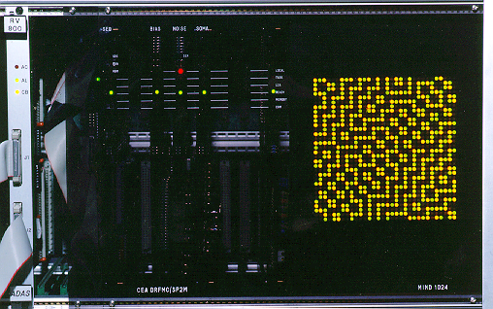
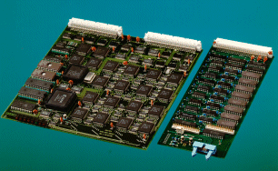
1990’s Neurocomputers...
Siemens : MA-16 Chips (SYNAPSE-1 Machine)
Synapse-1, neurocomputer with 8xM-A16 chips
Synapse3-PC, PCI board with 2xMA-16 (1.28 Gpcs)
Adaptive Solutions : CNAPS
SIMD // machine based on a 64 PE chip.
IBM : ZISC
Vector classifier engine
Philips : L-Neuro
1st Gen (1991): 16PEs 26 MCps
2nd Gen (1995): 12 PEs 720 MCps
+ Intel (ETANN), AT&T (Anna), Hitachi (WSI), NEC, Thomson (now THALES), etc…
CEA’s MIND machine
Hybrid analog/digital: MIND-128
Fully digital: MIND-1024
…
The rebirth of neuromorphic accelerators
2

Slide 3
1990’s Neurocomputers...
Siemens : MA-16 Chips (SYNAPSE-1 Machine)
Synapse-1, neurocomputer with 8xM-A16 chips
Synapse3-PC, PCI board with 2xMA-16 (1.28 Gpcs
Adaptive Solutions : CNAPS
SIMD // machine based on a 64 PE chip.
IBM : ZISC
Vector classifier engine
Philips : L-Neuro
1st Gen (1991): 16PEs 26 MCps
2nd Gen (1995): 12 PEs 720 MCps
+ Intel (ETANN), AT&T (Anna), Hitachi (WSI), NEC, Thomson (now THALES), etc…
CEA’s MIND machine
Hybrid analog/digital: MIND-128
Fully digital: MIND-1024
…
The rebirth of neuromorphic accelerators
3

Slide 4
1990’s Neurocomputers...
Siemens : MA-16 Chips (SYNAPSE-1 Machine)
Synapse-1, neurocomputer with 8xM-A16 chips
Synapse3-PC, PCI board with 2xMA-16 (1.28 Gpcs
Adaptive Solutions : CNAPS
SIMD // machine based on a 64 PE chip.
IBM : ZISC
Vector classifier engine
Philips : L-Neuro
1st Gen (1991): 16PEs 26 MCps
2nd Gen (1995): 12 PEs 720 MCps
+ Intel (ETANN), AT&T (Anna), Hitachi (WSI), NEC, Thomson (now THALES), etc…
CEA’s MIND machine
Hybrid analog/digital: MIND-128
Fully digital: MIND-1024
…
The rebirth of neuromorphic accelerators
4

Slide 5
1990’s Neurocomputers...
Siemens : MA-16 Chips (SYNAPSE-1 Machine)
Synapse-1, neurocomputer with 8xM-A16 chips
Synapse3-PC, PCI board with 2xMA-16 (1.28 Gpcs
Adaptive Solutions : CNAPS
SIMD // machine based on a 64 PE chip.
IBM : ZISC
Vector classifier engine
Philips : L-Neuro
1st Gen (1991): 16PEs 26 MCps
2nd Gen (1995): 12 PEs 720 MCps
+ Intel (ETANN), AT&T (Anna), Hitachi (WSI), NEC, Thomson (now THALES), etc…
CEA’s MIND machine
Hybrid analog/digital: MIND-128
Fully digital: MIND-1024
…
Orange video-grading
Chip alignment
Sleep phase analysis
Image compression
Satellite image analysis
LHC 1st level trigger
The rebirth of neuromorphic accelerators
5

Slide 6
Why Neural Networks are back?
Application needs– “big data” lead to process more and more unstructured data such as images, video, natural signals -, and Neural Networks are good machine-learning solutions,
Algorithmic progress - we are now able to “train” deep neural networks-, and they outperform classical approaches for image classification,

Slide 7
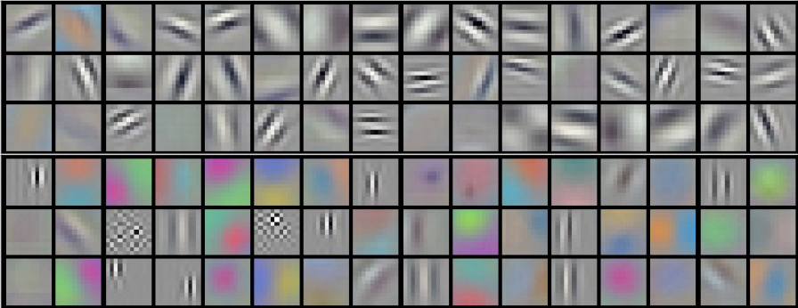
State-of-the-art in image classification
ImageNet classification (Hinton’s team, hired by Google)
14,197,122 images, 1,000 different classes
Top-5 17% error rate (huge improvement)
Facebook’s ‘DeepFace’ Program (labs headed by Y. LeCun)
4.4 million images, 4,030 identities
97.35% accuracy, vs. 97.53% human performance
650,000 neurons
60,000,000 parameters
630,000,000 synapses
From:Y. Taigman, M. Yang, M.A. Ranzato,
“DeepFace: Closing the Gap to Human-Level
Performance in Face Verification”

Slide 8
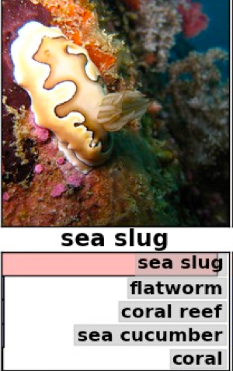
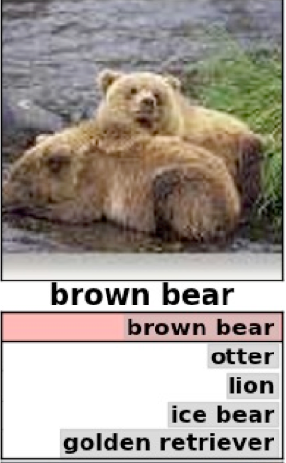
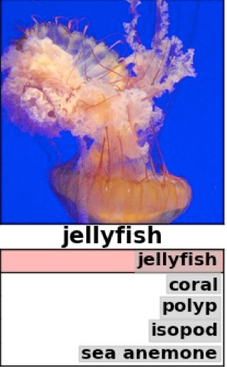
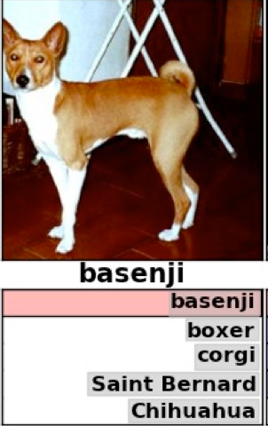
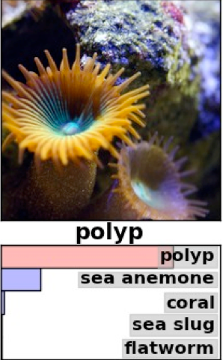
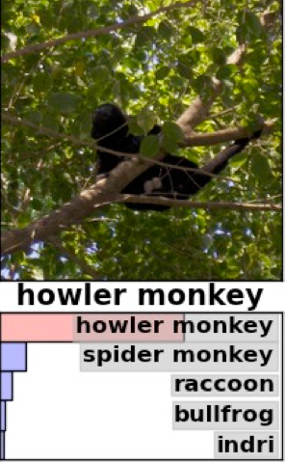
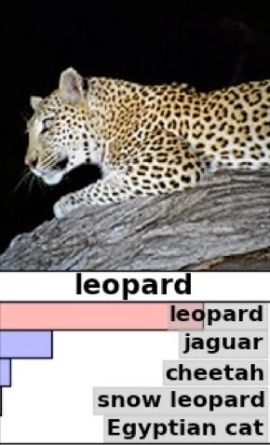
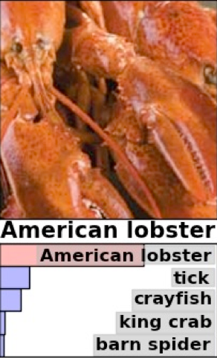
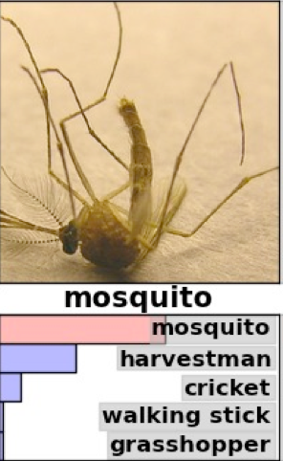
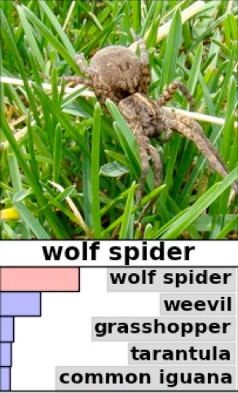
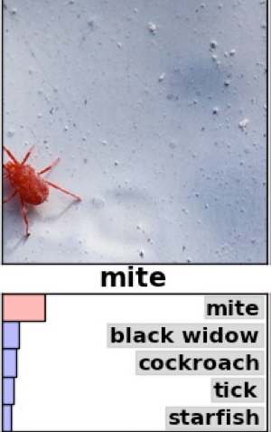
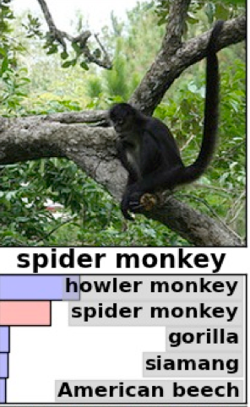
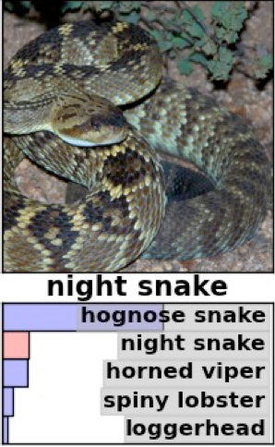
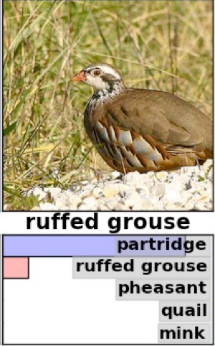
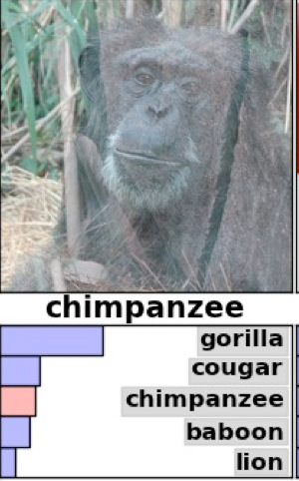
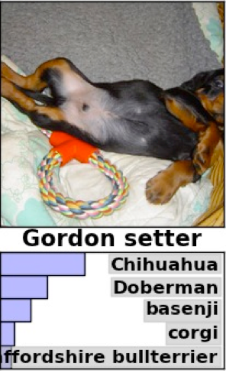
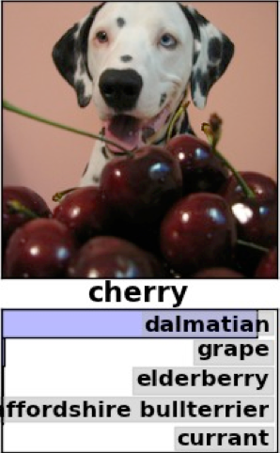
Examples of results (ImageNet)

Slide 9
Why Neural Networks are back?
Application needs– “big data” lead to process more and more unstructured data such as images, video, natural signals -, and Neural Networks are good machine-learning solutions,
Algorithmic progress - we are now able to “train” deep neural networks-, and they outperform classical approaches for image classification,
Technological - the high level of parallelism of neural networks can now be implemented in silicon-,
Software crisis – Explicitly programming a large set of processors is difficult, Neural Networks replace imperative programming by a “programming” by examples-,

Slide 10
Deep Neural Networks: state-of-the-art in image recognition
Database | # Images | # Classes | Best score
MNSIT Handwritten digits | 60,000 + 10,000 | 10 | 99.79%
GTSRB Traffic sign | ~ 50,000 | 43 | 99.46%
CIFAR-10 airplane, automobile, bird, cat, deer, dog, frog, horse, ship, truck | 50,000 + 10,000 | 10 | 91.2%
Caltech-101 | ~ 50,000 | 101 | 86.5%
ImageNet | ~ 1,000,000 | 1,000 | Top-5 83%
DeepFace | ~ 4,000,000 | 4,000 | 97.25%
“Programming” by example,
Not explicit, imperative programming
INCREASING COMPLEXITY

Slide 11
What is a neural network
The « formal » neuron:

Slide 12
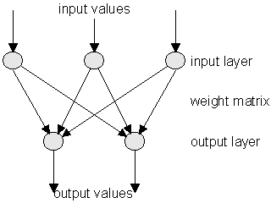
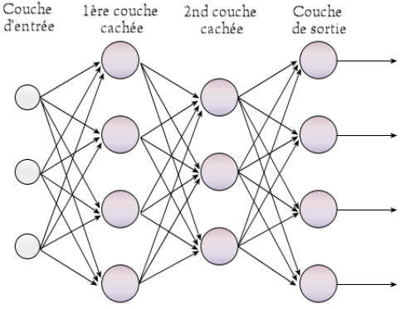
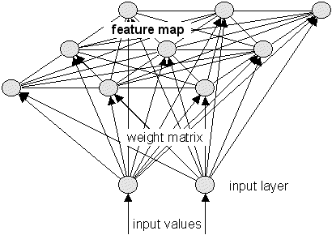
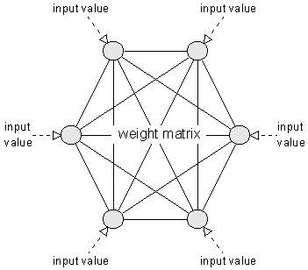
Topology of Neural networks
Connections between formal neurons…
Perceptron
Rosenblatt -- 1957-58
Multi-layer Perceptron
Kohonen Self-Organizing
Maps
And more…
Hopfield

Slide 13
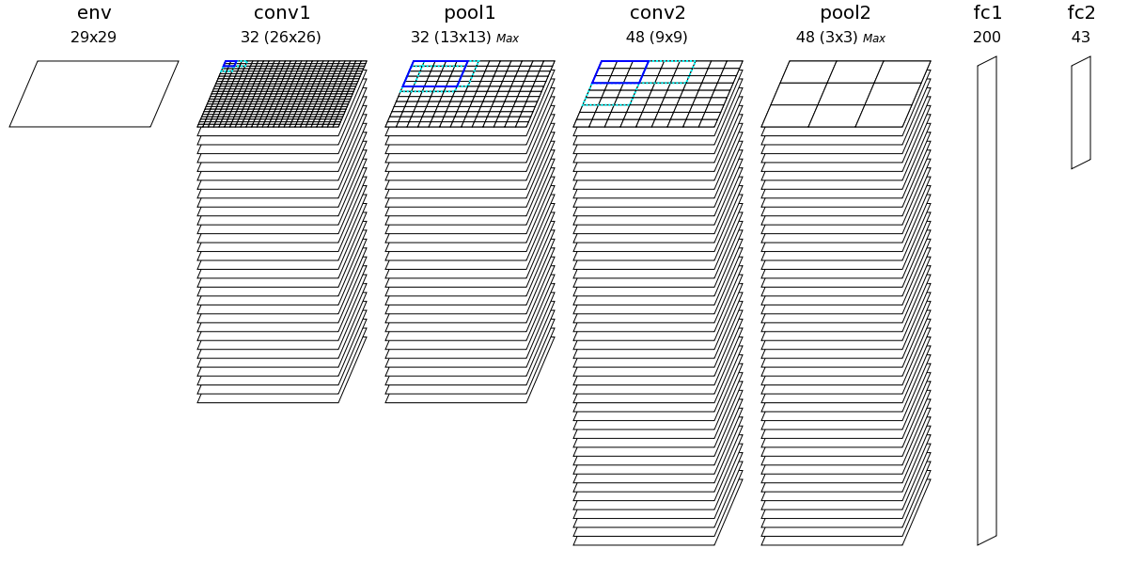
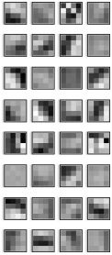
What is a Deep Network, CNN?
…
…
…
Deep = number of layers >> 1
13
Notes:
Stacking of several convolutional layers
Pooling layer: take the maximum value over small input areas, called receptive fields
In the final layer, each neuron correspond to a different input class (1 neuron / class)

Slide 14
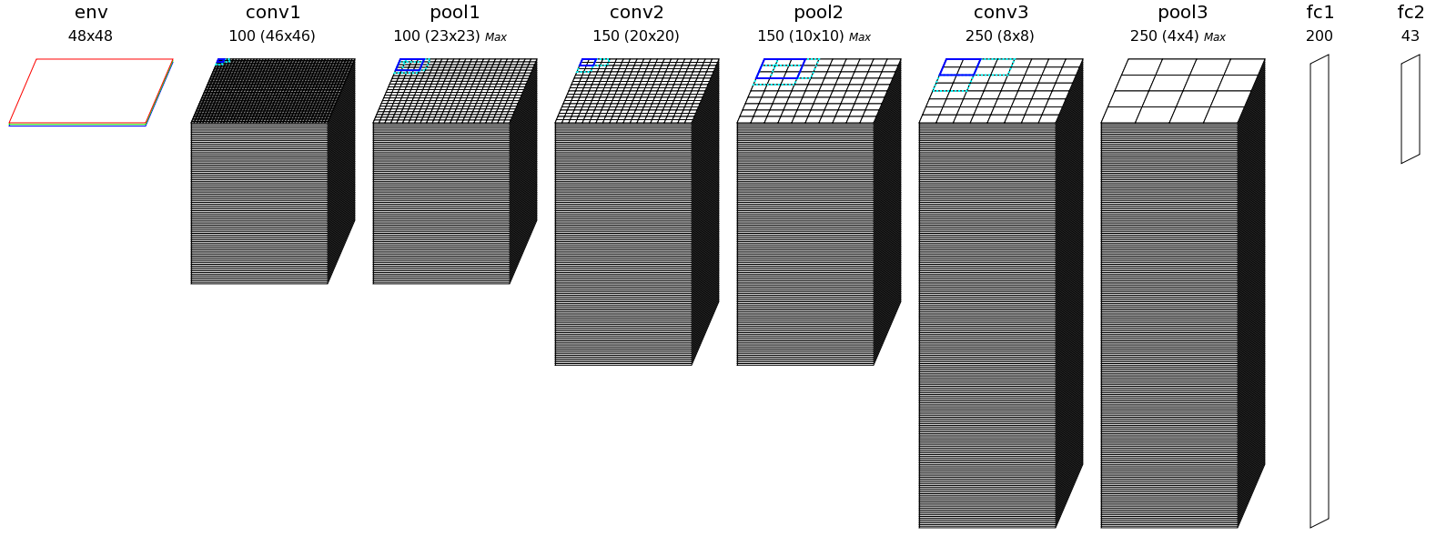
Example of size of a typical CNN
The German Traffic Sign Recognition Benchmark (GTSRB)
43 traffic sign types
> 50,000 images
Neurons: 287,843
Synapses: 1,388,800 – Total memory: 1.5MB (with 8 bits synapses)
Connections: 124,121,800
From: D. Ciresan, U. Meier, J. Masci, J. Schmidhuber, Multi-column deep neural network for traffic sign classification, Neural Networks (32), pp. 333-338, 2012
Near human recognition (> 98%)
14
Notes:
8 layers, 3 conv layers
What are the consequences of having that many synapses & connections?

Slide 15
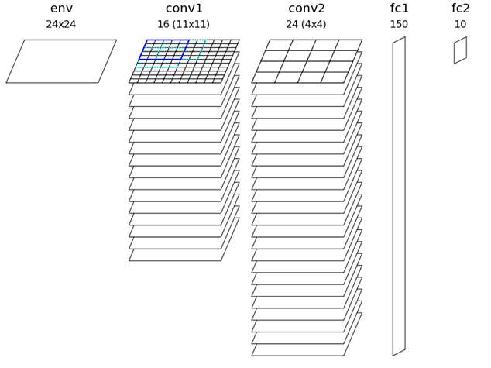
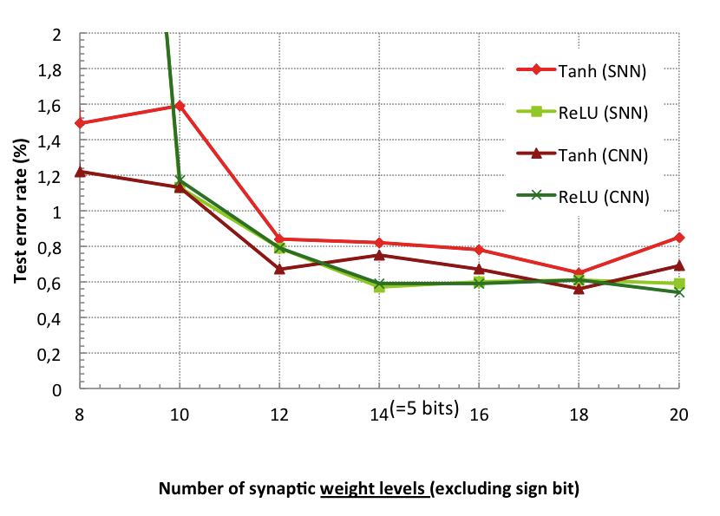
Simplifying the computations
Data representation reduction
Example on the MNIST handwritten digits database (60,000 images)
Reduction down to 5 bits
Using simple saturation instead of Tanh
➔ Recognition rate drop < 0.2%

Slide 16
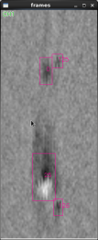
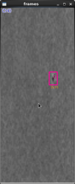
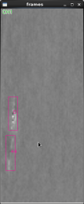
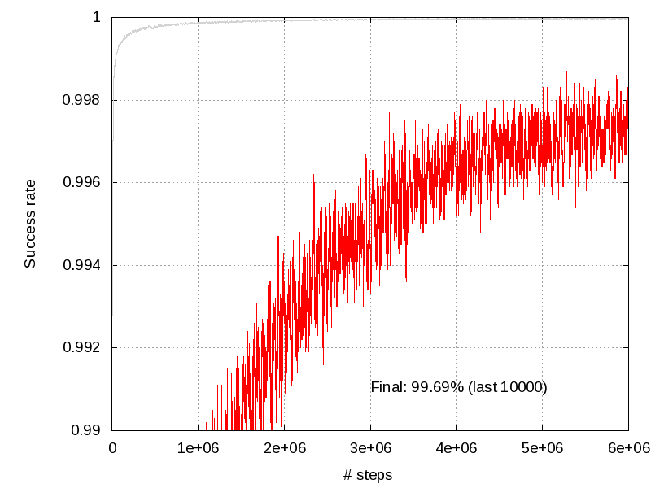
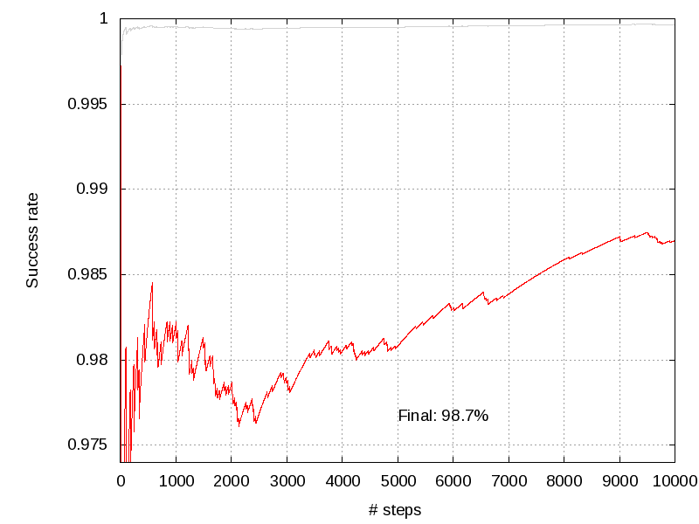
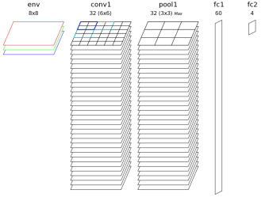
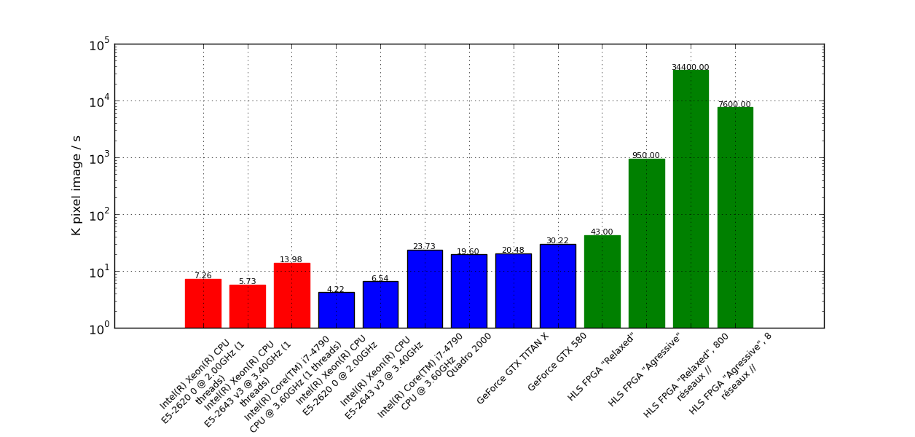
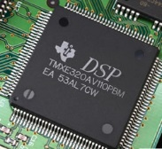
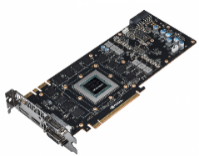
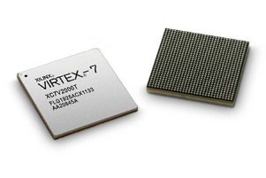
Fast and accurate NN exploration
Automated architecture mapping and benchmarking tool flow
1) Deep network builder
2) Learning a database
3) Analysis of network performances
; Environment
[env]
SizeX=8
SizeY=8
ConfigSection=env.config
[env.config]
ImageScale=0
; First layer (convolutionnal)
[conv1]
Input=env
Type=Conv
KernelWidth=3
KernelHeight=3
NbChannels=32
Stride=1
; Second layer (pooling)
[pool1]
Input=conv1
Type=Pool
PoolWidth=2
PoolHeight=2
NbChannels=32
Stride=2
; Third layer (fully connected)
[fc1]
Input=conv2
Type=Fc
NbOutputs=100
; Output layer (fully connected)
[fc2]
Input=fc1
Type=Fc
NbOutputs=10
Learning
Output categories and localization
Recon. rate
Test
Recon. rate
Xnet software framework
4) CPU, GPU and FPGA-based real-time implementation
 OpenMP
 OpenCL
 HLS FPGA

Slide 17
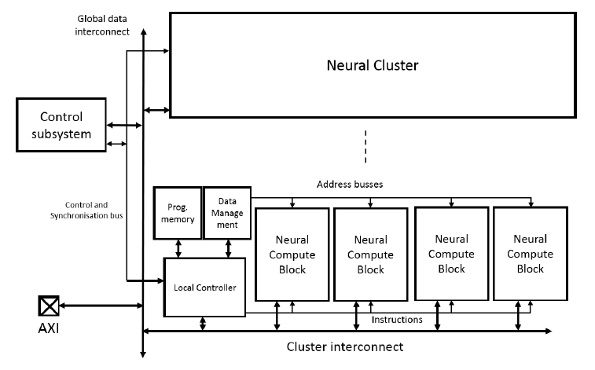
Optimized DSP for NN: NeuroDSP
Energy efficient HW accelerator
Design for DNN processing chains
Supporting also traditional image processing algo.
Clustered SIMD architecture
Optimized operators for MAC & NL-approximation
First experiments based on an FPGA
Including 3 clusters (96 PEs) & the
full system
Validation realized on a real CNN application
Mapped on NeuroDSP & Designed with XNet
Caltech-101 database, 96% accuracy
FPGA version is already competitive with existing CPU & GPU solutions
➔ x3.8 MOPS/W energy efficiency vs Quad ARM A7
Platform / Prog. Model | Energy efficiency MOPS/W
NeuroDSP (FPGA) | 765
Intel CoreI7 | 27
GPU | 65
Quad ARM A7 | 200

Slide 18
But Neural Networks have other properties
They are inherently tolerant to computation errors
Good candidate for “approximate computations”
That fits with natural signal processing, with no “exact algorithm”
Therefore, they don’t necessarily need binary coding
Temporal coding, like “spike coding”, can be energy efficient
It is also more similar to coding in the nervous system
Mixed analog/digital implementations can de efficient:
For a set of five signal applications:
Hardware accelerator: area cost of 1.63mm2
only 2.3% of the energy of an Atom-like core
From: Bilel Belhadj, Antoine Joubert, Zheng Li, Rodolphe Héliot, and Olivier Temam. 2013.
Continuous real-world inputs can open up alternative accelerator designs.
SIGARCH Comput. Archit. News 41, 3 (June 2013), 1-12

Slide 19
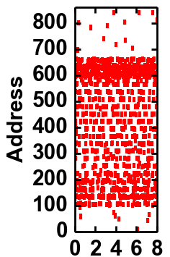
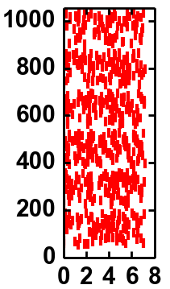
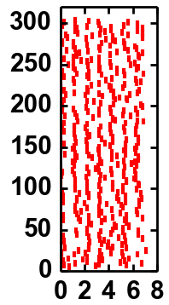
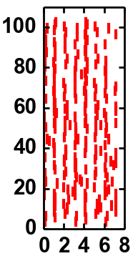
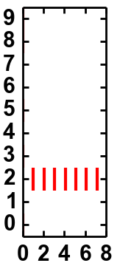
Spike-based Coding
Pixel brightness
Spiking frequency
V
f_{MIN}
29x29 pixels 841 addresses
Rate-based input coding
f_{MAX}
t
layer 1
layer 2
layer 3
layer 4
Correct
Output
Time

Slide 20
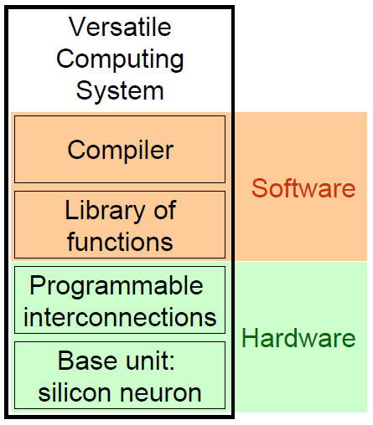
SNN Hardware Accelerator
Spiking Neural Network (SNN) hardware accelerator for DSP functions
Combination of Hardware and Software
Software: Libraries of mathematical functions and a Compiler
Hardware: SNN circuit composed of Analog Leaky-Integrate and Fire (LIF) neurons
Two test chips implemented in 65nm
Reptile: 3 tiles of 12 neurons
Spider: 25 tiles of 12 neurons
Advanced technology nodes
Comparison of Analog and Digital neurons
Gain of Analog neuron (less area)

Slide 21
Also potential for new learning rules
Spike-based processing can also be interesting to implement local learning rules
This can rely on physical phenomenon, not only floating point computations

Slide 22
Learning from neuroscience: a STDP Primer
Neuron
STDP = correlation detector
➔ Possible learning model of the mind?
Electrical
signal
pre-synaptic Neuron
post-synaptic Neuron
Axon
Synapse
Dendrite
Causality
Potentiation (LTP)
<
<
Synaptic weight modification (%)
t_{pre}
t_{post}
t_{post}
t_{pre}
Anti-Causality
Depression (LTD)
Δt = t_{post} - t_{pre}

Slide 23
Principle of STDP on Crossbars of Memristors
First Proposed by Snider(1)
Post-synaptic spike
(feedback)
Synaptic weight update through STDP
V_{pre}
V_{post}
t_{pre} < t_{post}
t_{pre} > t_{post}
Neurons
V_{pre}
t_{pre}
t_{pre}
t
t
Pre-synaptic spike
V_{post}
t_{post}
t_{post}
t
t
R
V_{pre}
-V_{post}
dR
dt
t
V_{th}
V
-V_{th’}
t
-V_{th’}
R decreases
R increases
V_{th}
V
G. Snider, Nanoscale Architectures, 2008
B. Linares-Barranco et al, Nature Precedings, 2009

Slide 24
Can it compute? A 2 synapses’ dog!
Experimental setup for a Pavlovian associative memory based on memristive devices as proposed by Di Ventra et col.²
Association is made
Food
¹ O. Bichler, W. Zhao, F. Alibart, S. Pleutin, S. Lenfant, D. Vuillaume, C. Gamrat, “Pavlov's Dog Associative Learning Demonstrated on Synaptic-like Organic Transistors”, Neural Computation, 2012
² Pershin, Y.V. & Di Ventra, M. “Experimental demonstration of associative memory with memristive neural networks.” Arxiv 0905.2935 (2009).
Bell
Salivation

Slide 25
Unsupervised learning example
Results
98% cars detection rate
High noise tolerance: same detection rate with 50% added noise
Very High variability immunity: good performances with 20% synaptic variability (> 95% on learned traffic lanes)
2nd layer
Lateral
inhibition
1st layer
Lateral
inhibition
……
……
128
AER Sensor
16,384 spiking pixels
128
Two-layers system
~ 2 million devices with STDP
…
…
…
O. Bichler, D. Querlioz, S. J. Thorpe, J.-P. Bourgoin and C. Gamrat, “Unsupervised Features Extraction from Asynchronous Silicon Retina through Spike-Timing-Dependent Plasticity”, International Joint Conference on Neural Networks IJCNN August 2011
Elementary patterns
Shapes
Objects
Hierarchical Architecture Proposal

Slide 26
Weights Evolution During Learning
Synaptic maps for 4 neurons on the first layer
Output 1
Output 2
Recorded stimuli
Output 3
Output 4

Slide 27
Is it feasible? CBRAM memristor test chip
CMOS/CBRAM Co-integration
130 nm CMOS process
CBAM technology Ag/ GeS₂ / W
Proof of concept circuit
4*4 Crossbar (1CB)
4*4 Matrix (1CB – 1T)
Chip under test
Crossbar : 4.72 µm * 4.72 µm
Matrix : 5.15 µm * 7.1 µm

Slide 28
Novel NVMs-based Architectures
From spiking pre-synaptic neurons (inputs)
Unsupervised cars trajectories extraction
V_{RD}
I_{LTP}
I_{LTD}
I = I_{LTP} - I_{LTD}
PCM
Crystallization/
Amorphization
Spiking post-synaptic neuron (output)
Equivalent
2-PCM synapse
O. Bichler et al., “Visual pattern extraction using energy-efficient ’2-PCM synapse’ neuromorphic architecture.” Electron Devices, IEEE Transactions on, 2012
Unsupervised MNIST handwritten digits classification with stochastic learning
CBRAM
Forming/
Dissolution of
conductive filament
M. Suri et al., “CBRAM devices as binary synapses for low-power stochastic neuromorphic systems: Auditory (cochlea) and visual (retina) cognitive processing applications”, IEDM, 2012 + M. Suri et al., IEDM 2011 + D. Garbin et al., IEDM 2014

Slide 29
Conclusion: Overview of some trends…
Limit of frequency scaling -> parallelism, multi-cores
Limit of energy density -> simple, small, efficient cores
New devices will be small, but have large dispersion, low reliability -> error tolerant architectures
New NVRAMS -> Co-locating compute and storage
Cost of moving data -> prefer locality, “computing in memory”
3D interconnect
More and more “natural data processing” -> new compute paradigms, without explicit programming, in hybrid systems
Neural Networks satisfy all theses trends…

Slide 30
Evolution of computing?
« The McCulloch-Pitts result puts an end to this. It proves that anything that can be completely and unambiguously put into words is ipso facto realizable by a suitable finite neural network. »
J . Von Neumann, 1951
Finally something that can be named after me!
Evolution: Moore and Darwin, similar result?

Slide 32
Thank you for your attention

